Slide 1
Human Activity and its Environmental Impact
Profa. Beatriz Soledad

Slide 2
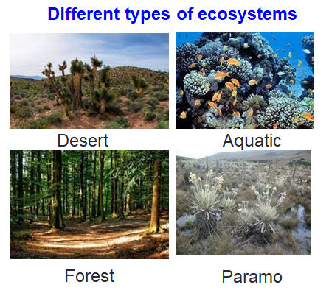
ECOSYSTEM
An ecosystem is a geographic area where plants, animals, living beings and organisms interact under certain environmental conditions (according to climate, temperature, type of soil, etc.)
It is made up of two types of elements or factors:
  Biotic elements. They are those elements that have life, that is, all the living beings that inhabit it (flora and fauna).
  Abiotic elements. They are those lifeless factors, that is, the place they inhabit. (climatic conditions, relief, pH variation, presence of sunlight).

Slide 3
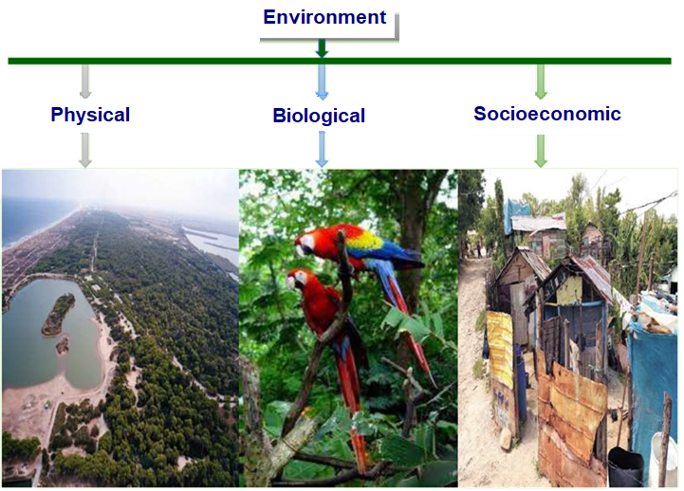

Slide 4
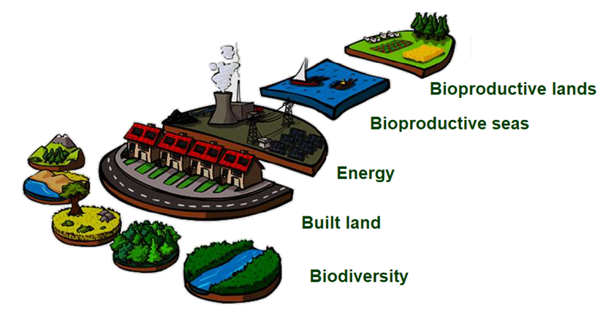
Ecological footprint
Ecological footprint, measure of the demands made by a person or group of people on global natural resources

Slide 5
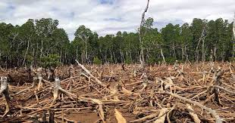
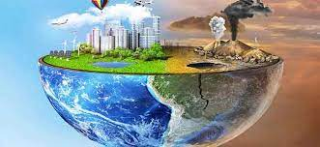
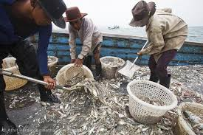
Types of Human Activities That Impact the Environment
Deforestation
Clearing forests for agriculture or urban development has led to habitat loss and increased CO₂ emissions.
Pollution
The release of harmful substances into the air, water or soil causes negative impacts on both ecosystems and human health.
Overfishing
Overfishing beyond sustainable levels has caused population decline and alteration of aquatic ecosystems.

Slide 6
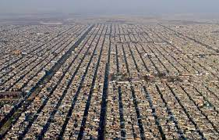
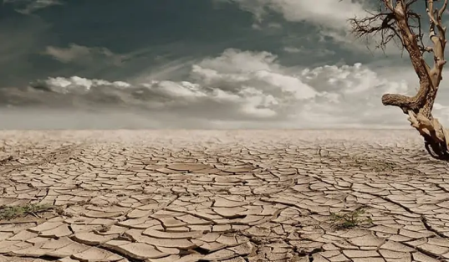
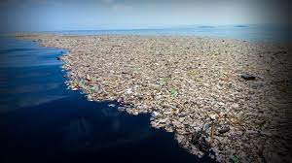
Urban Sprawl
Cities have expanded uncontrollably into surrounding areas, causing the loss of natural habitats and increased pollution and traffic congestion.
Water shortage
Without water, life does not exist on this planet. A massive environmental problem of our time exists in the form of the Water shortage
Plastic waste in the sea
Plastic is not biodegradable, 8 million tons end up directly in the sea every year. About 32 million tons simply end up as Plastic waste in the environment and then via detours in the oceans.

Slide 7
Causes and Effects of Human Activity on the Environment
Industrialization
Industrial activities have intensified due to increasing demand for energy and resources, contributing to air and water pollution, as well as habitat destruction.
Biodiversity Loss
The ecological balance has been altered and biodiversity on the planet has been reduced due to habitat destruction, pollution and overexploitation
Climate Change
Greenhouse gas emissions from burning fossil fuels and deforestation have caused rising global temperatures, resulting in melting ice caps, extreme weather events, and disrupted ecosystems.
Health Impacts
Poor air and water quality, as well as exposure to toxic substances, cause various diseases such as respiratory and cardiovascular diseases.

Slide 8
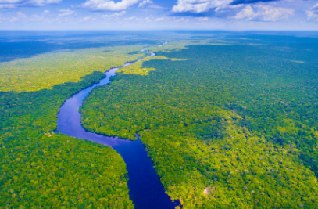
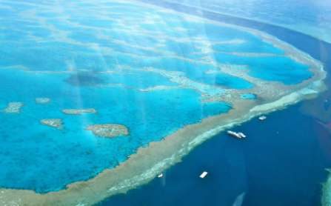
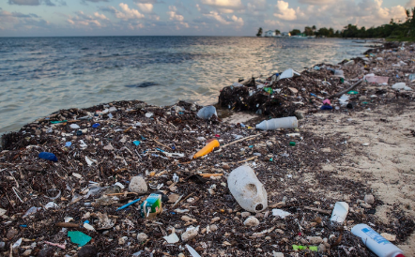
Case Studies of Human Impact on the Environment
Amazon Rainforest
Widespread deforestation in the Amazon rainforest has led to loss of biodiversity, increased carbon dioxide emissions, and displacement of indigenous communities.
Great Barrier Reef
Coral bleaching has occurred as a result of rising ocean temperatures and pollution, threatening the biodiversity and ecological health of the world's largest coral reef system
Plastic Pollution
The excessive use and improper disposal of plastic waste have resulted in massive oceanic garbage patches and harmful effects on marine life and ecosystems.

Slide 9
Solutions to Reduce Human Impact on the Environment
Renewable Energy
Dependency on fossil fuels and greenhouse gas emissions can be reduced by transitioning to clean, renewable energy sources such as solar and wind.
Sustainable Agriculture
We can help protect soil health, conserve water, and reduce chemical inputs by adopting sustainable agricultural practices, such as organic farming.
3. Conservation Efforts
By establishing protected areas, implementing wildlife conservation programs and promoting sustainable tourism, we can help preserve biodiversity and natural habitats.

Slide 10
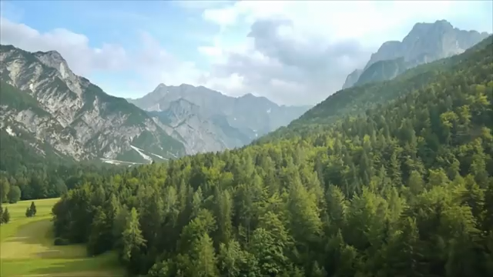

Slide 11
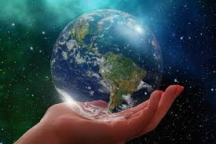
Conclusions
Our actions have a profound impact on the environment, however we can achieve favorable change.
We can protect the planet for future generations, by adopting sustainable practices and supporting environmental initiatives.

