Slide 1

GLG-VENEZUELA
GUÁRICO STATE
VENEZUELA

Slide 2
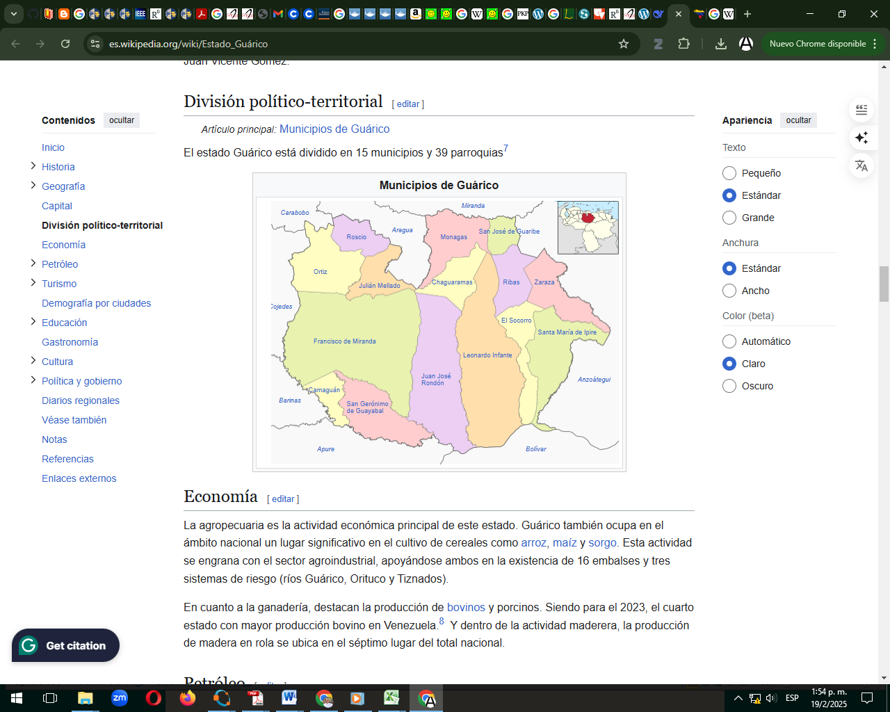
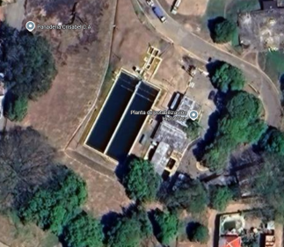
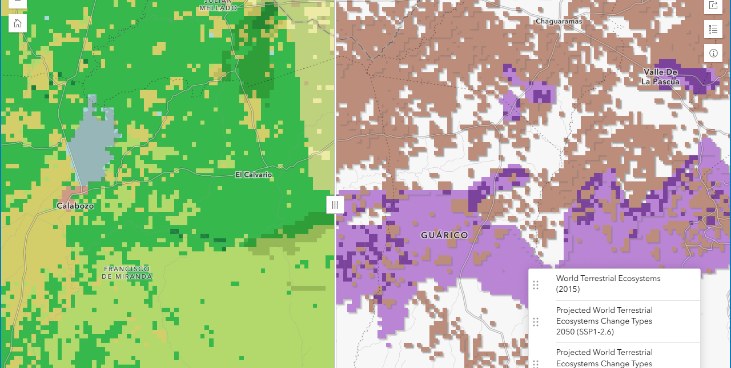
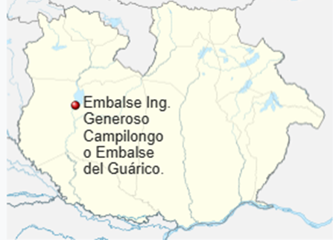
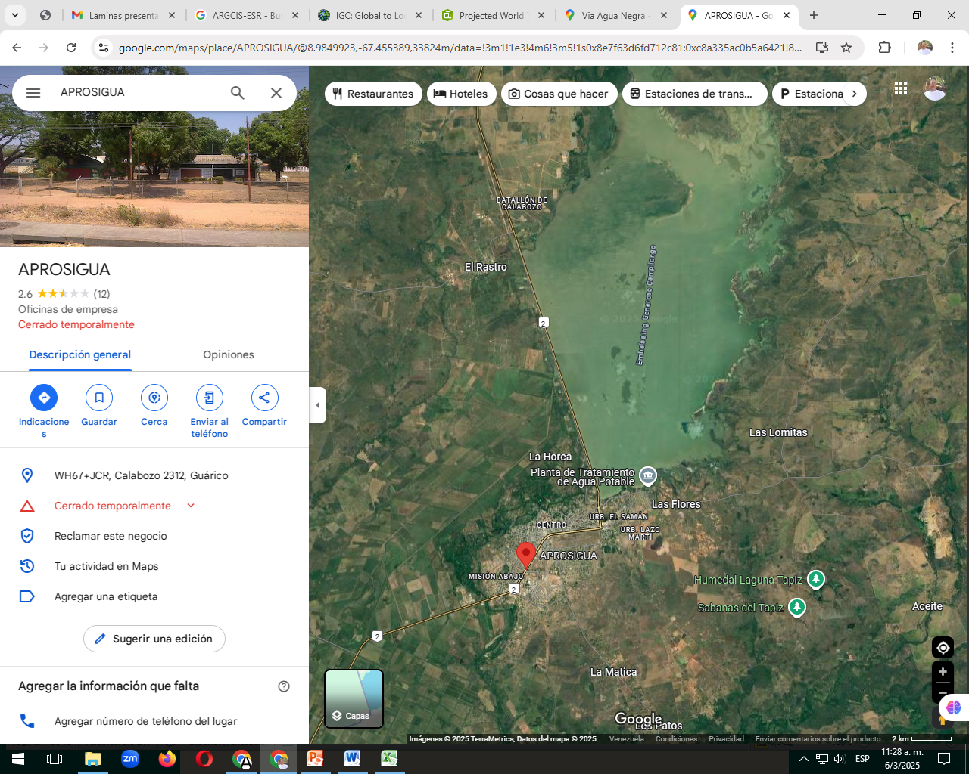
Description: The State of Guárico, located in the heart of Venezuela, extends over an area of approximately 64,986 km², making it one of the largest states in the country. Its population, according to recent estimates, is around 746,000 inhabitants. Geographically, Guárico is characterized by its vast plains, which form part of the Central Plains, offering a landscape dominated by extensive savannahs. . The economy of state is characterized by cereal crops such as rice, corn and sorghum and livestock, as well as timber production..
Gaps: Anzoátegui represent a series of demographic challenges, the disorderly growth has generated problems to basic services such as housing, education and health. Eviromental pollution, a product of oil activity and urban expansion, also represents a significant challenge.
Arguments: Research in Venezuelan laws like The Constitution, environmental, animal, plant, ocean, industry, agriculture, settlement, water and forest, Venezuela census. Also in IA like Gemini and especifics research paper by area of interest
Some ARGCIS-ESRI satellitate images 2050 change with SSP3-7.0, principal changes aridity only and land cover only

Slide 3
PROJECT SELECTION
State and city of state selection |  | Project Selection and codification in Gantt Chart |  | Project Cost | Total Utility
 |  |  |  | ($/km2/year) | (tons CO2e/$/km2/year)
1-Guarico | San Juan de lo Morros, hidro Paéz; embalse de Calabozo | WAT_06 | Lake restoration, Enhance lake restoration | 13.000 | 0,385
2-Guarico | San Juan de los Morros, San Carlos | TRN_09 | Fossil fuel vehicles removal | 100.000 | 0,4
3-Guarico | San Carlos | STL_03 | Green infrastructure enhancement | 50.000 | 0,2
4-Guarico | San Carlos | AGR_01 | Enhance protection of productive soils | 5.000 | 1,6
5-Guarico | Tiznados, Guárico, El Cigarrón, La Becerra, El Pueblito. | ENE_05 | Hydro energy production | 180.000 | 1,6
6-Guarico | Tiznados, Guárico, El Cigarrón, La Becerra, El Pueblito. | ENE_01 | Solar photovoltaic energy production Enhance solar photovoltaic energy production | 200.000 | 0,25
7-Guarico | subcuenca del río Guárico | FOR_03 | Sustainable forest management, Enhance sustainable grassland management | 12.000 | 0,833

